Slide 1

Investment Business Plan
For XYZ Pvt. Lmt.

Slide 2

Problem
Statement
To identify which Cab Company is performing better and is a better investment opportunity for XYZ Pvt. Lmt.

Slide 3

Provided Information
Overview
01

Slide 4
Four Data Sets Descriptions
Customer Data
City Data
Transactions
Cab_Data
Shape : (49171, 4)
Freatures :-
1. Customer ID
2. Age
3. Gender
4. Montly Income USD/moth
Shape : (20, 3)
Freatures :-
1. City
2. Population
3. User
Shape : (1999, 3)
Freatures :-
1. Transaction ID
2. Customer ID
3. Payment_Mode
Shape : (1998, 12)
Freatures :-
1. Transaction ID
2. Date of Travel
3. Company
4. City
5. KM Travelled
6. Price Charged
6. Cost of Trip
Notes:
Let’s dig deeper into the individual provided Data Sets...

Slide 5
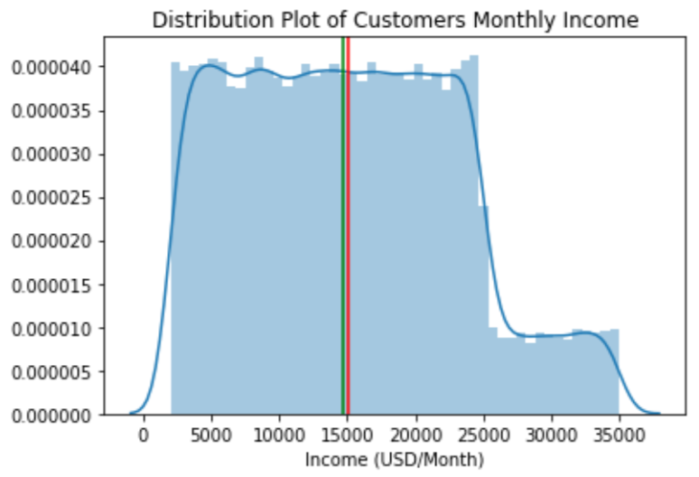
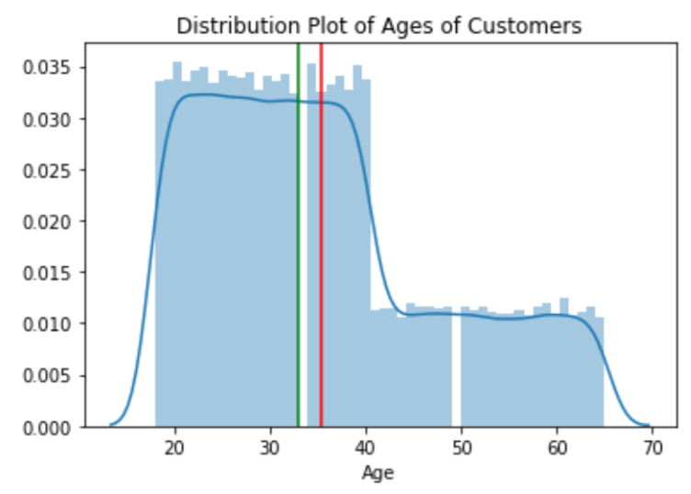
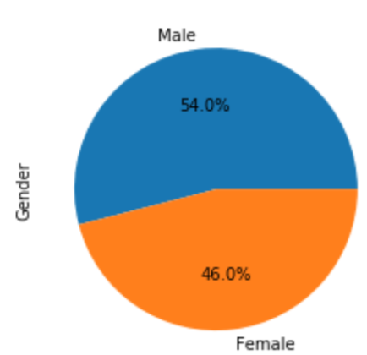
Customer Data Set
This clearly describes the demographics of the customers - cabs using people in general ( not w.r.t. yellow and pink cab users)
1. GENDER : 54% Male - higher and 46% Female - slightly lesser
2. MONTHLY INCOME:
Min: 2000
Max: 35000
Mean: 14656
2. AGE :
Min : 18
Max : 65
Mean: 33
Notes:
The distribution of Age : maximus spread is from 20yrs - 45 yrs
Distribution of Income is spread from 2500 - 25000 USD : Cab users…..
M n F : almost equally use cabs

Slide 6
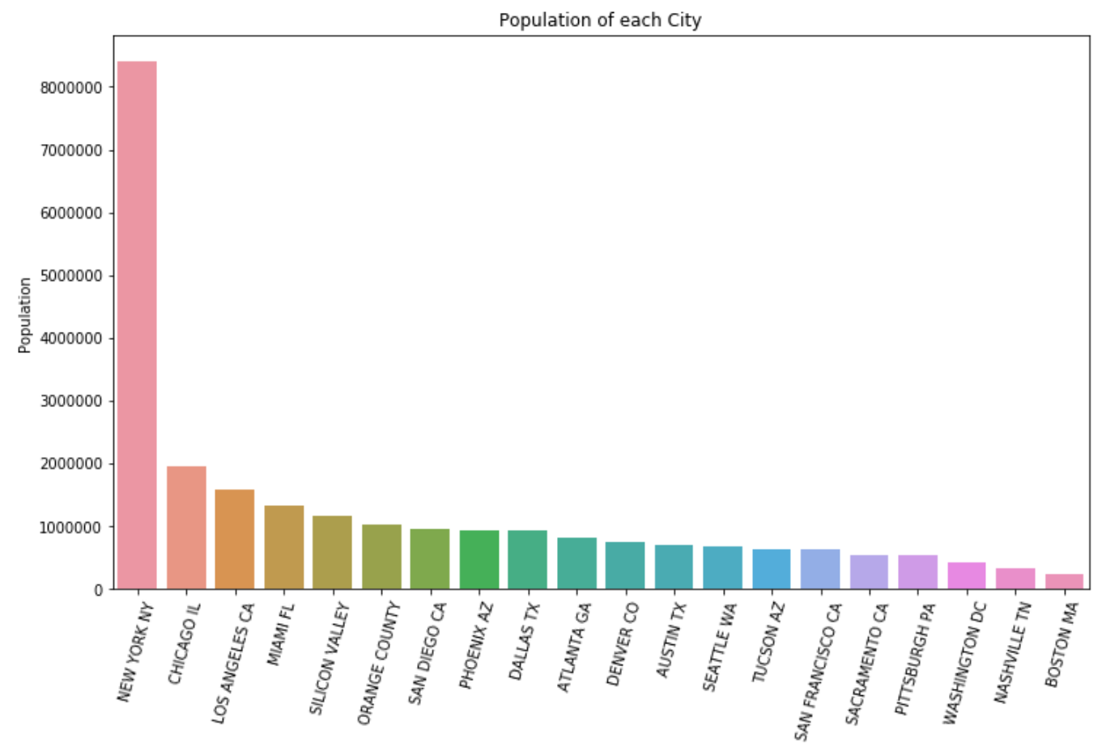
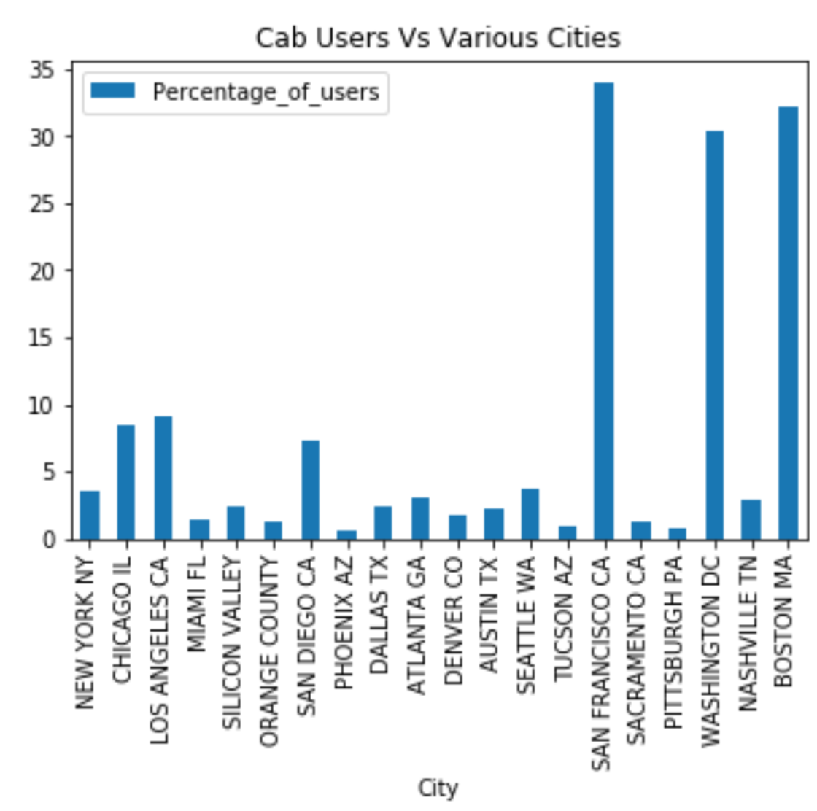
City Data Set
Relationship between population and cab users is given by ‘ Percentage of Users.’
Although, New York is having a huge population, cab users are less than 5%,
In terms of Population:
- Highest : New York
- Least : Boston
In terms of Cab Users in a particular City:
- Highest : San Francisco
- Least : Phoenix, Arizona
Notes:
Although, New York is having a huge population, cab users are less than 5%,
and Vice Versa!

Slide 7
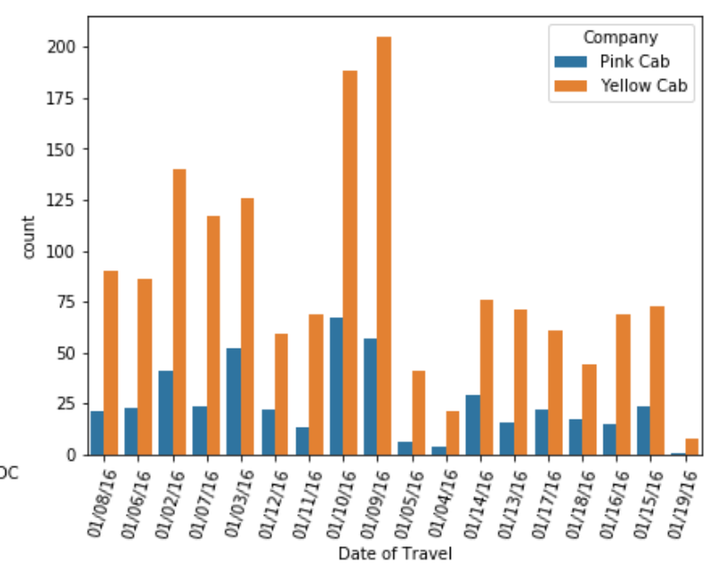
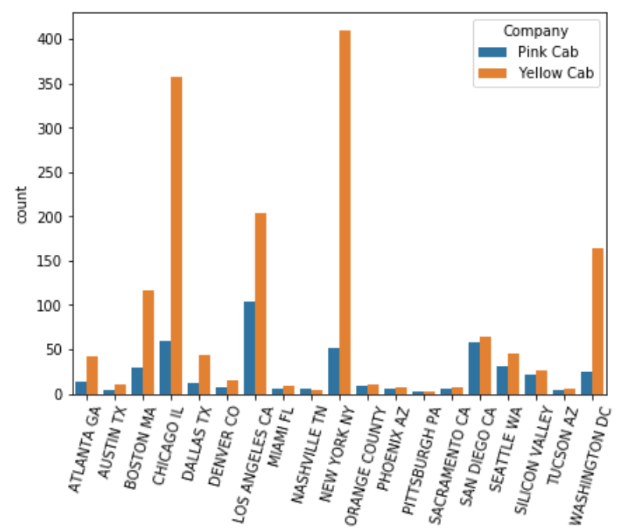
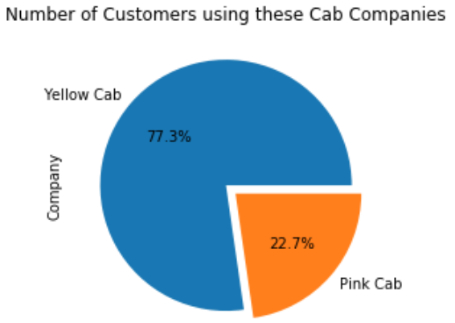
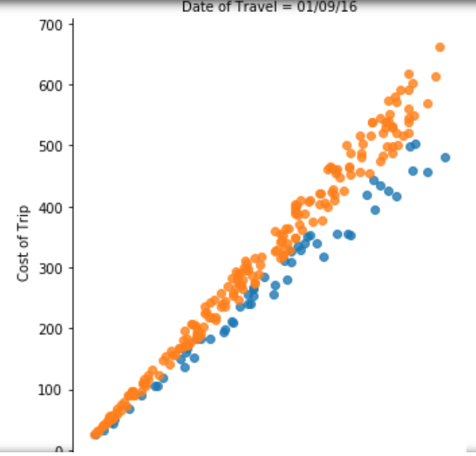
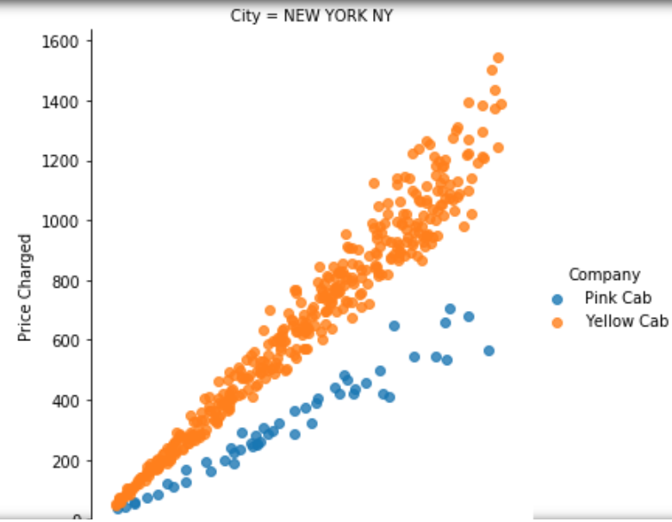
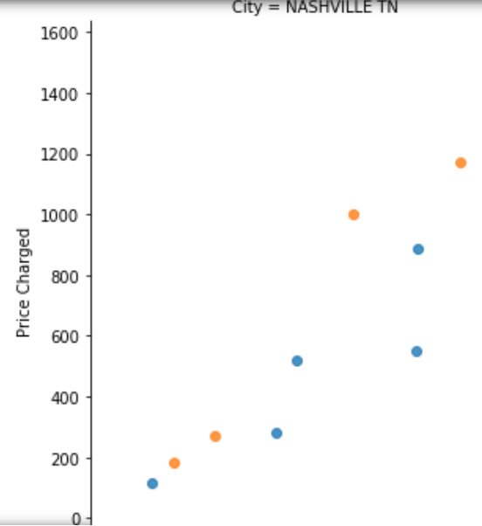
Cab Data Set
This Data Set includes the information exclusively of the two Cab Companies : Pink Cab and Yellow Cab.
This data set shows for each customer individually.
Stratified Data Given : Yellow Cab is populated in the given data set.
Each particular day and in almost every city, except very few, yellow cabs usage is more than double than Pink cab usage.
Notes:
the data is biased towards yellow cab for sure, so everything what we do will tend pointing towards it.

Slide 8
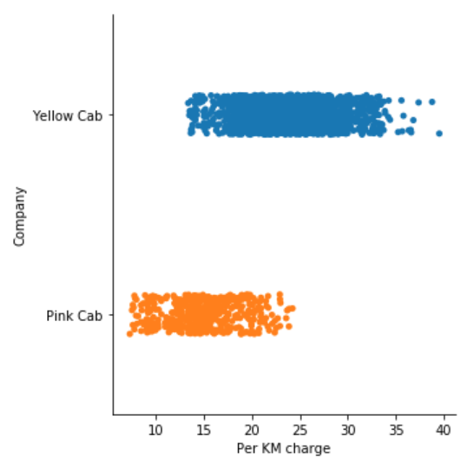
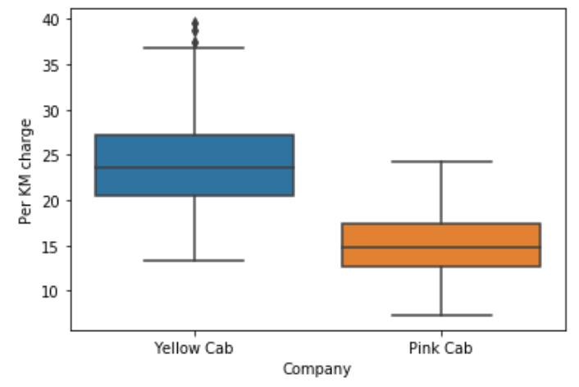
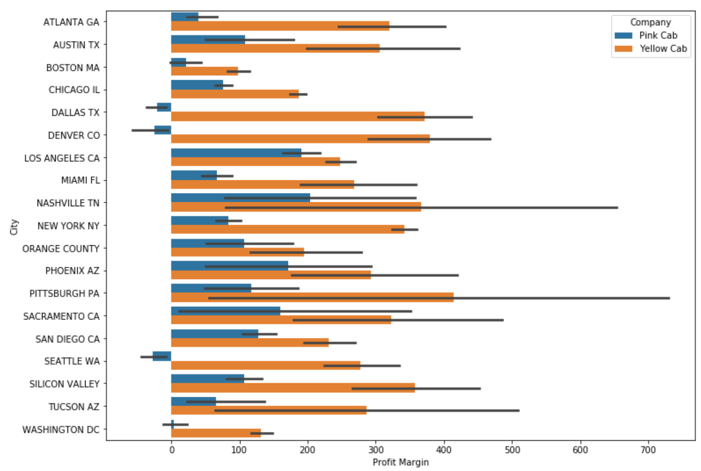
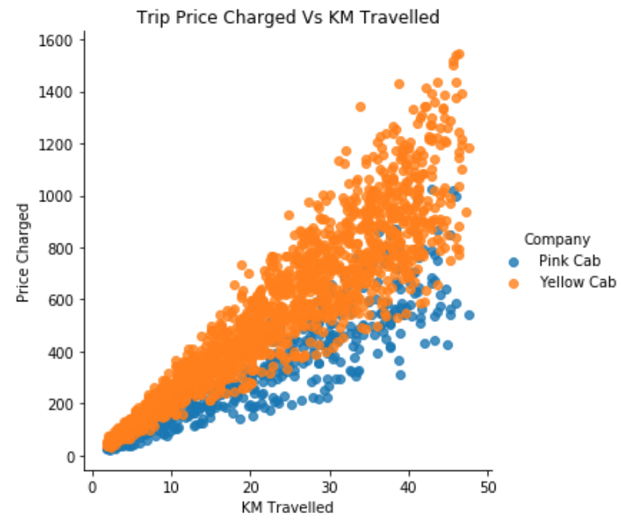
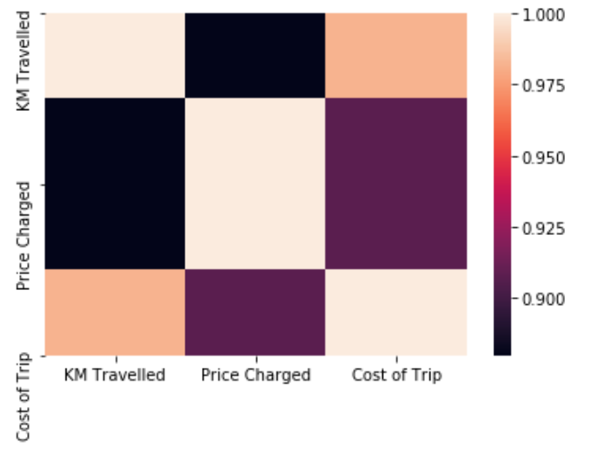
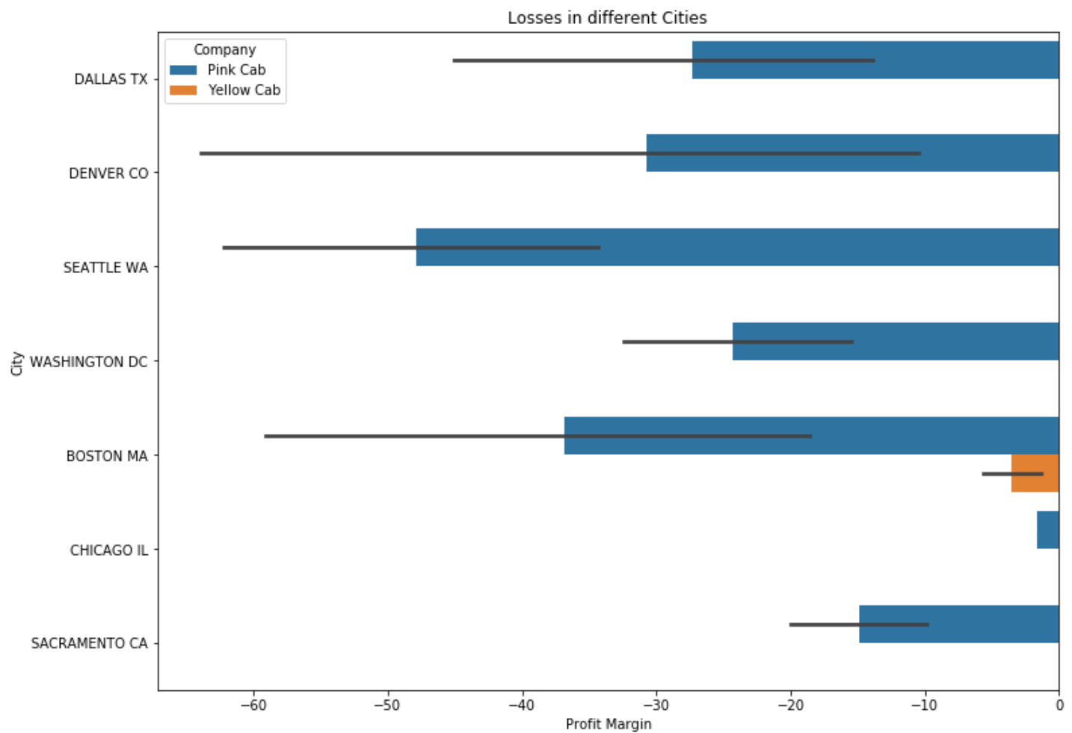
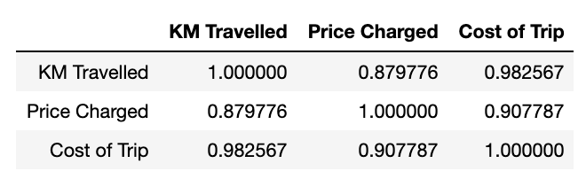
Market Trends
1. Per KM charges of Yellow cab : 14 to 40 USD.
And for Pink cab : 3 to 27 USD
Mercury is the closest planet to the Sun and the smallest one in the Solar System—it’s only a bit larger than our Moon. The planet’s name has nothing to do with the liquid metal, since it was named after the Roman messenger god, Mercury
3. Losses are incurred by Pink Cab alone.
2.There is a high correlation between cost of trip and price charged.

Slide 9
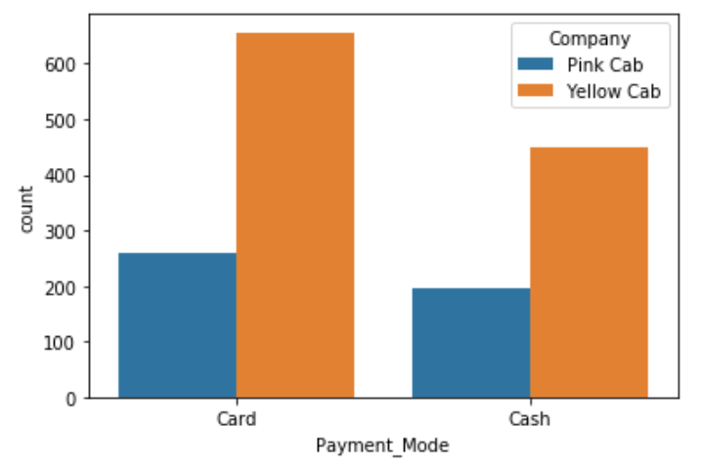
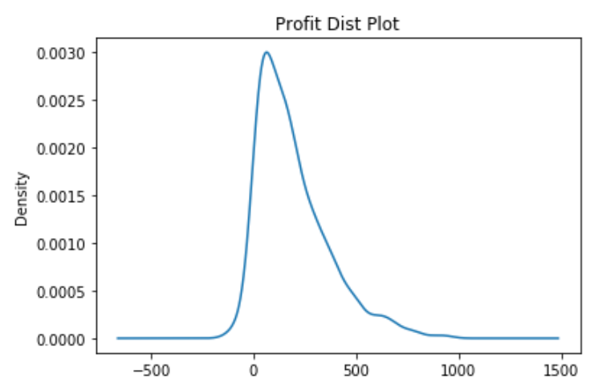
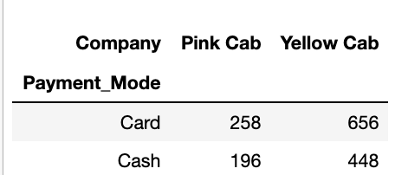
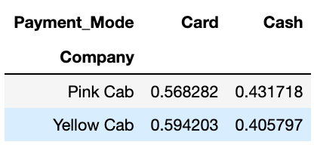
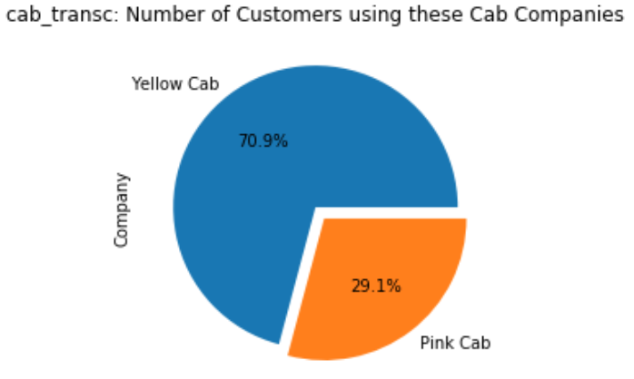
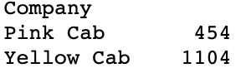
Cab and Transaction Data
Yellow Cab data > Pink cab data
Card usage is > Cash usage to make transactions
Profit is right skewed.
This data is going to give us the actual number of trips made w.r.t. customers.

Slide 10

Problem
Solution
The Data given is a Stratified Data. It is more biased towards Yellow Cab.
Can be solved by using either OVER SAMPLING or UNDER SAMPLING.
But, under sampling can cause loss in Information and cannot give us insights of information aptly.

Slide 11

Total Analysis and
Inferences
02

Slide 12
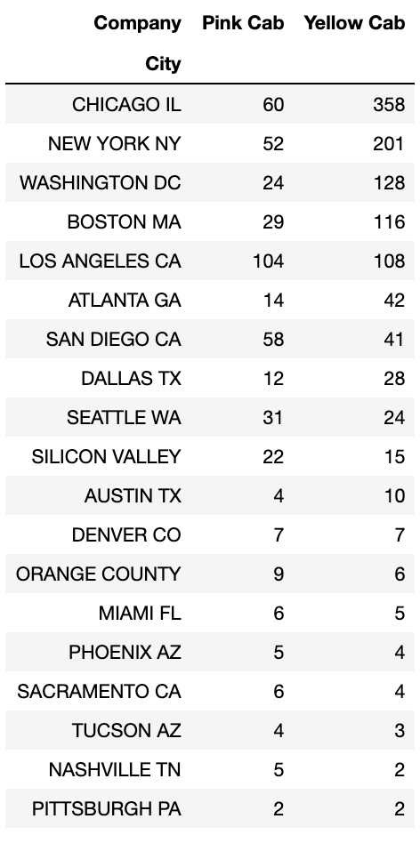
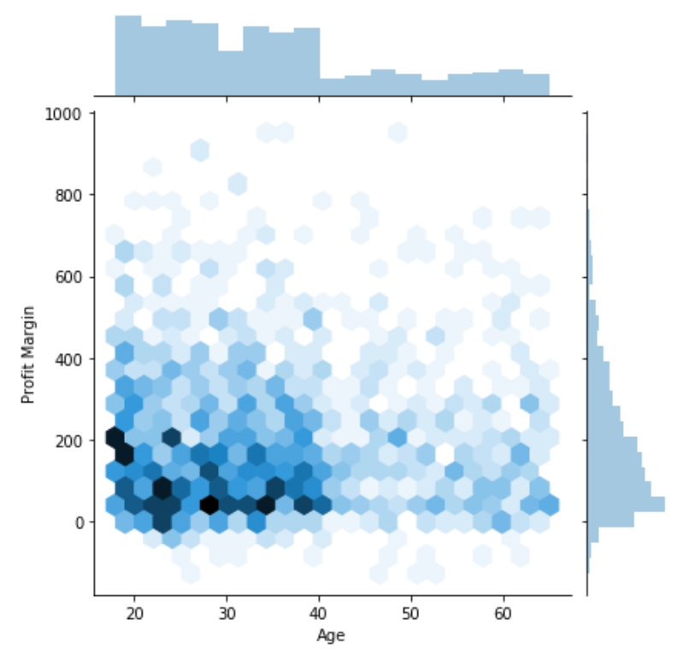
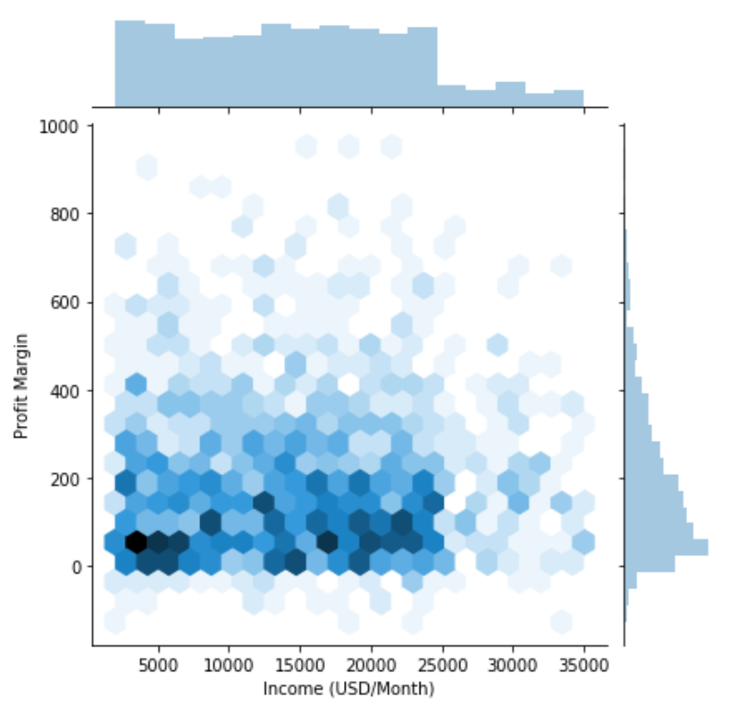
Market Trends
Mercury is the closest planet to the Sun and the smallest one in the Solar System—it’s only a bit larger than our Moon. The planet’s name has nothing to do with the liquid metal, since it was named after the Roman messenger god, Mercury
1. Maximum profits made lie in the age group of 20 - 40 years
2. Maximum profits made lie in terms of Income, is almost same and greater for less income people.
3. Eastern parts of the country : More trips made, yellow being the highest.

Slide 13

Hypothesis Testing
03

Slide 14

Hypothesis Testing on following:
Age Group
Income Group
2 Companies Profit
Mode of Payment
Ttest_indResult(statistic=0.8114254593633214, pvalue=0.41724548571413733)
Age doesnt have any impact on the MARGIN OF PROFIT
Ttest_indResult(statistic=0.4218969711620938, pvalue=0.6731585021926946
Income doesnt have any impact on the MARGIN OF PROFIT
F_onewayResult(statistic=229.4322328853904, pvalue=1.890863084900095e-48)
Company causes a high impact on Profit Margin
Ttest_indResult(statistic=2.453985057501583, pvalue=0.014237214431379559)
Mode of payment has an impact on the MARGIN OF PROFIT

Slide 15

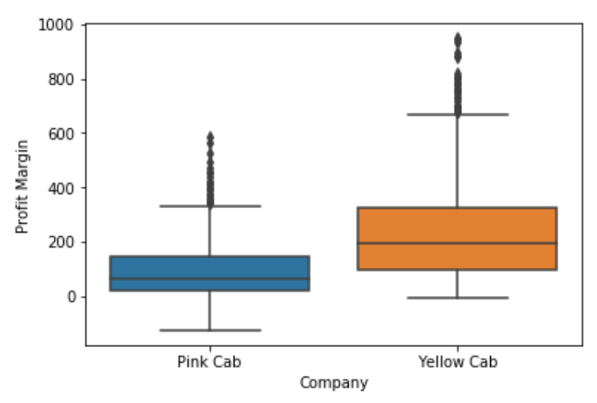
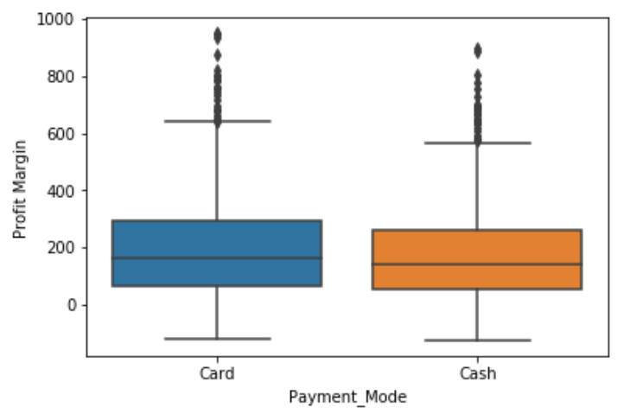
Post Hoc:
Profit Margin
It shows that for Yellow Cab,
the profit margin is greater.
Mode of Payment
Card Payment drives more profit, is inferred Statistically.

Slide 16

Assumptions and Conclusions
04

Slide 17
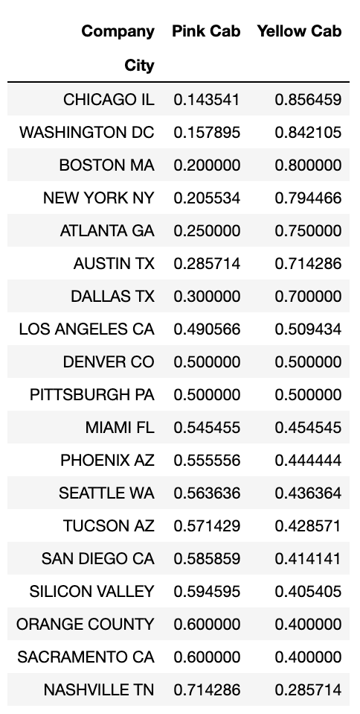
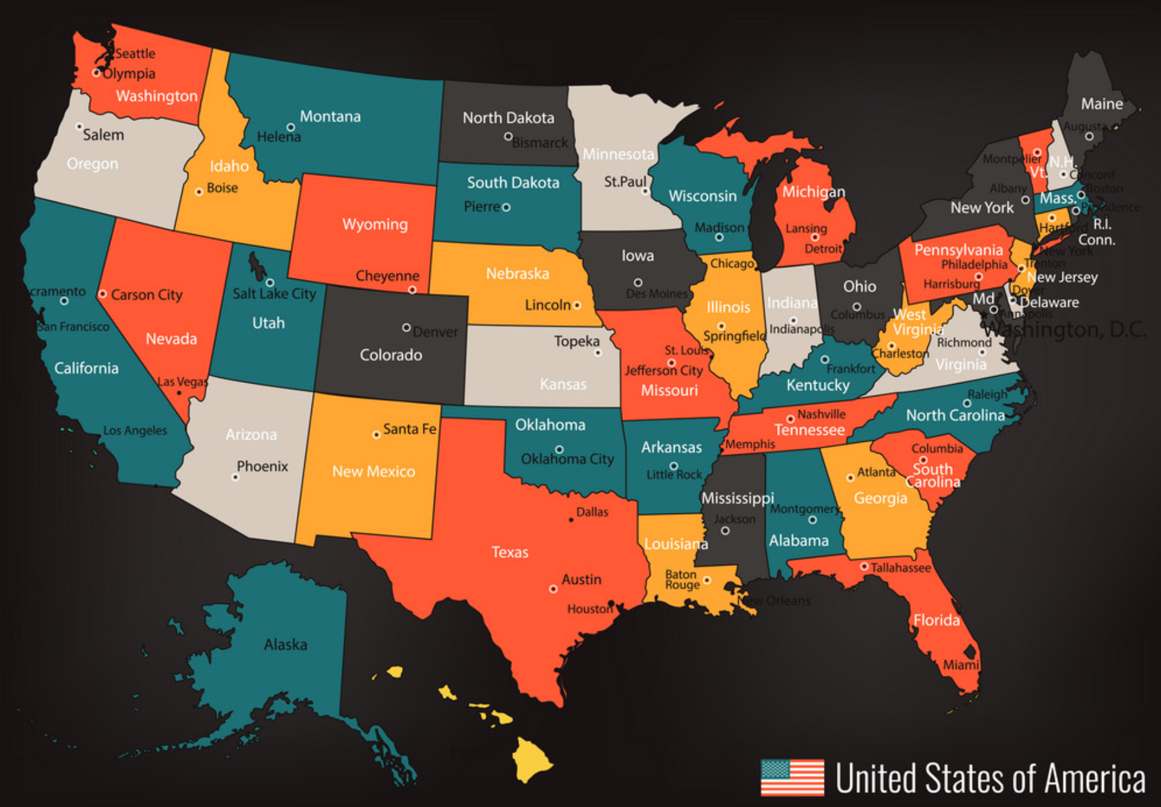
Market Trends
Mercury is the closest planet to the Sun and the smallest one in the Solar System—it’s only a bit larger than our Moon. The planet’s name has nothing to do with the liquid metal, since it was named after the Roman messenger god, Mercury
1. Majority of the Cab usage is from the west.
2. In most of the middle and southern cities : Preference of Pink Cabs is greater.

Slide 18

Demographics
(city wise spread )
2%
North
42%
East
36%
West
20%
South

Slide 19
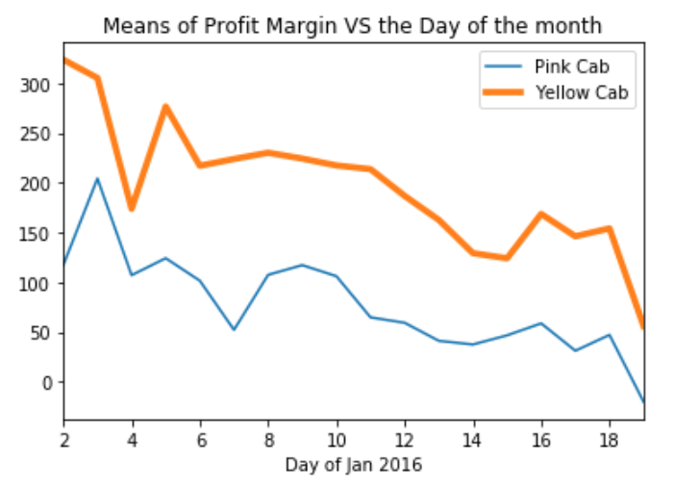
Market Trends
Sat to
Sun
There is a huge PROFIT made in the beginning of the month, and sharp declination in between and towards the end of the moth, there is . a slight fluctuation - Yellow Cab.
Both the company, follow a similar trend, and Pink Cab margin lying much below to Yellow Cab in terms of Profits.
Mercury is the closest planet to the Sun and the smallest one in the Solar System—it’s only a bit larger than our Moon. The planet’s name has nothing to do with the liquid metal, since it was named after the Roman messenger god, Mercury
Sat to
Sun
Sat to
Sun
Sat to
Sun

Slide 20
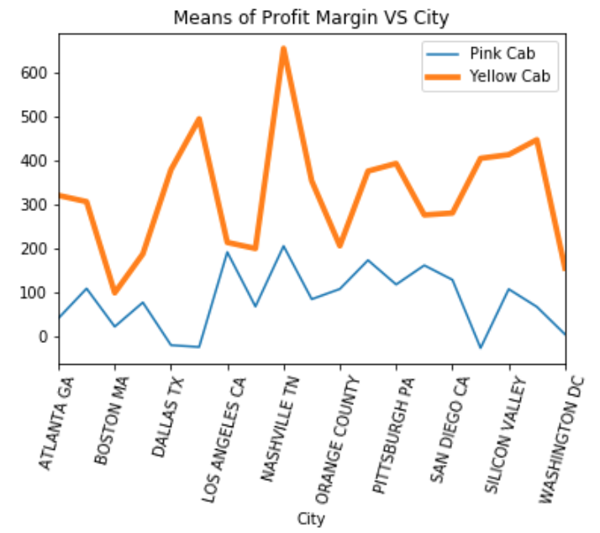
Market Trends
There is a huge PROFIT made in Nashville.
There is a similar trend for both the cabs: Pink and Yellow Cabs.
In California, Pink Cabs are actually incurring losses, although they are more populated in those near by cities.
Mercury is the closest planet to the Sun and the smallest one in the Solar System—it’s only a bit larger than our Moon. The planet’s name has nothing to do with the liquid metal, since it was named after the Roman messenger god, Mercury

Slide 21

Assumptions
Prices Charged
Cities
Yellow cab is priced higher : still preference is more for it.
Frequency of Cabs
Pink Cab is newer
Trust, Reliably on the brand
Where the Cab usage is lesser, Pink cabs are travelling more.
May be it is operational in those cities.

Slide 22
Conclusions
Profits Made
Geographically
Day
Yellow cabs are the most in terms of Profits made.
And many losses by Pink Cab
On the West near to California, Pink Cab usage is higher but the usage of cabs is very less.
On the East and South Eastern parts, Yellow cabs are most used and preferred.
Since, the profit margins are changing day to day, I suggest you to invest in the beginning weeks of the months

Slide 23
Thank You

